Slide 1
Standards for Asset Identification and Location

Slide 2
Agenda
Asset Identification and Location Workshop #2
Recap
Use Case walk through - test how easy the navigation is for several different scenarios.
Review Location Hierarchies for:
"Main 8"
Other Buildings
Car Parks
External Streets
Taxiway/Runways
Flesh out building areas for the remaining "Main 8”.

Slide 3
Recap
Different Stakeholders view location from different perspectives
Grid
Building
Tenancy
Recommended Location Structure for FM navigation
Main 8 Buildings
Other Buildings
Car Parks
External Streets
Taxiways/Runways
Location References
Sectors
Co-Ordinates
Army
Airforce
Airport
Building Numbers
Tenancy Numbers
Door Numbers
Toilet Block Numbers
Asset #s to be auto-generated for simplicity and as a foundation for future GIS/BIM integration.

Slide 4
Recap
Issues Identified
A co-ordinated process is required for updates:
Retail: Tenancy Moves
Property: Properties becoming SACL Assets
New Projects: Asset Commissioning
Site number from Oracle
An AKA (Also Known As) register is required to assist with identification.
“Ownership” of assets - Who’s responsible.

Slide 5
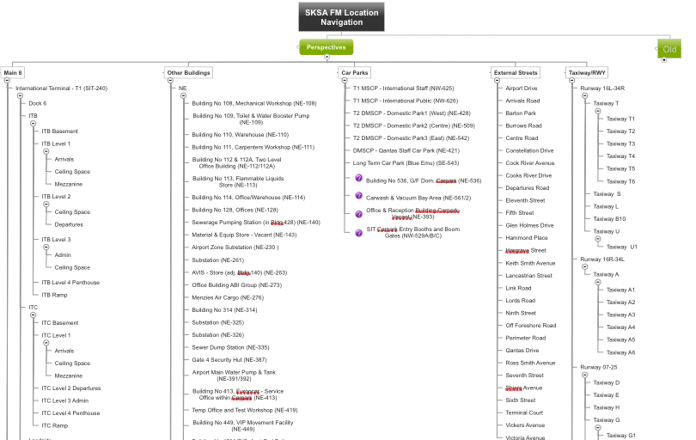
Review Location Hierarchy

Slide 6
Agenda
Asset Identification and Location Workshop #2
Recap
Use Case walk through - test how easy the navigation is for several different scenarios.
Review Location Hierarchies for:
"Main 8"
Other Buildings
Car Parks
External Streets
Taxiway/Runways
Flesh out building areas for the remaining "Main 8”.

Slide 7
Agenda
Asset Identification and Location Workshop #2
Recap
Use Case walk through - test how easy the navigation is for several different scenarios.
Review Location Hierarchies for:
"Main 8"
Other Buildings
Car Parks
External Streets
Taxiway/Runways
Flesh out building areas for the remaining "Main 8”.

Slide 8
Next Steps

Slide 9
Use Case walk through
Test how easy the navigation is for several different scenarios.

Slide 10
Location & Asset Hierarchies – Why?
Using systems of locations and always knowing the location of an asset provides the ability to track valuable information on the history of assets, including asset performance at specific sites, and asset movements between locations.
It provides the agility to query and optimise the placement of assets in a logical structure which in turn provides the user with an interface which is devoid of any clutter. A well thought out hierarchy provides the ability to:
Identify the location of an asset as it exists within the business
Identify accurately where work is being done
Roll-up costs to the correct level
Capture condition data at the right place
Drill-down to the lowest component of an asset or physical location
Identify, manage and mitigate risks associated with locations/assets

Slide 11
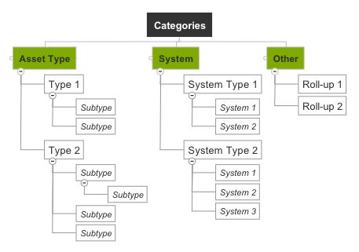
Asset Identification
Site
Facility (Building)
Floor
Floor
Facility (Building)
Floor
Space (room)
Space (room)
Space (room)
Space (room)
Classification
Location
Locate an Asset
Manage by Asset type. Roll-Up
Asset
Component
Component
The Asset Detail PMs, Work Orders, Costs, Etc.

Slide 12
Asset Identification
The Asset/Sub-Assets (Asset Hierarchy)
An asset is a piece of equipment, a tool, a vehicle or any entity that you want to track charges against.
Assets (assembly or parent) may contain sub-assets (component or child).
E.g. Chiller may have pump, valves, controls as components.
Now you can charge general inspections against the assembly asset, but if you find problems during the inspection, you can charge the work against the actual subcomponent.
The effort of maintaining an asset increases exponentially with the depth of hierarchy.
Assets can be grouped according to Classifications
Location
A location is a place, usually in a geographical sense (it could also be a location along a process).
Locations can have a parent-child hierarchy
E.g. Site, Facility (Building), Floor, Space (Room)
Asset Classifications
Asset Type, Key Systems,
Used to manage asset by type etc.
Used to roll-up information
Other Classifications:
E.g. Zone – e.g. HVAC. Linear – e.g. road tunnel, rail line. Consists – e.g. trains

Slide 13
Assets and Locations
Location
Assumed not to have financial value
Work performed at location
Work and cost history based on location field (many assets)
Cost rollup calculates value of work completed at sub-locations
Holds the default GL code for work
Tracks status
Can have item, calendar, meters, specification
Is independent of assets installed at location
Can exist in multiple System hierarchies
Asset
Assumed to have financial value
Work performed on asset, at a location
Can have vendor, manufacturer and serial number
Can have spare parts and sub-assemblies
Can be “rotatable” (repairable, and can exist within a store location)
GL code for asset and location (merged)
Tracks status
Can have item, calendar, meters, specification
Work and cost history based on asset field (many locations)

Slide 14
Rule of Thumb
An Asset
Is over $1,000 in cost, or
It can be repaired or rebuilt and put back into service. Everything else is a spare part, not an asset.
E.g., a $25 relay is a spare part because it meets neither of these criteria, but a $1,500 contactor is an asset because it meets both.
N.B. Some lower value items may be managed as an asset, if they are mission critical/high risk.

Slide 15
Asset Identification
Site
Facility (Building)
Floor
Floor
Facility (Building)
Floor
Space (room)
Space (room)
Space (room)
Space (room)
Classification
Location
Locate an Asset
Manage by Asset type. Roll-Up
Asset
Component
Component
The Asset Detail PMs, Work Orders, Costs, Etc.

Slide 16
Agenda
Asset Identification and Location Workshop
Location & Asset Hierarchies - Why? >RM
Some Definitions >RM
Recap on Asset Categorisation work to date >All
Current Issues & Challenges with Asset and Location identification >All
Planning for the future >RM
Next Steps >All

Slide 17
Agenda
Asset Identification and Location Workshop
Location & Asset Hierarchies - Why? >RM
Some Definitions >RM
Recap on Asset Categorisation work to date >All
Current Issues & Challenges with Asset and Location identification >All
Planning for the future >RM
Next Steps >All

Slide 18
Agenda
Asset Identification and Location Workshop
Location & Asset Hierarchies - Why? >RM
Some Definitions >RM
Recap on Asset Categorisation work to date >All
Current Issues & Challenges with Asset and Location identification >All
Planning for the future >RM
Next Steps >All

Slide 19
Asset Numbers
There are a number of approaches for numbering Assets.
Two common approaches are:
Sequential Numbering Conventionally in Maximo Locations are given meaningful names as the places to find the asset. The assets themselves are given a unique sequential number that is generated by, and maintained within, Maximo.
Descriptive Asset IDs Sydney Airport has overtime used a number of descriptive identification conventions.
A future consideration is the potential integration of external systems that create assets, e.g. GIS/IBIM. Typically these systems will request an asset number be auto-generated by Maximo (as the master for location/asset numbers) when they register the asset.

Slide 20
Agenda
Asset Identification and Location Workshop
Location & Asset Hierarchies - Why? >RM
Some Definitions >RM
Recap on Asset Categorisation work to date >All
Current Issues & Challenges with Asset and Location identification >All
Planning for the future >RM
Next Steps >All

